Slide 1
Why learn Jèrriais?
#learnjèrriais

Slide 2
Where is Jersey? Où est qu’ est Jèrri?
Jersey lies just 14 miles from the French Normandy coast.

Slide 3
Jersey in ancient times
At the end of the Ice Age (11,700 years ago) Jersey was part of a single landmass – what we now recognise as Western Europe.

Slide 4
Our French roots…
8000 years ago the Island was still connected to France by a coastal plain.

Slide 5
The Island’s separation from France…
About 6000 years ago the water rose and cut Jersey off from the ’mainland’.

Slide 6
The Jersey Language - Jèrriais
Latin arrived in this area with the Romans two thousand years ago.
Over a thousand years Latin evolved into many different regional languages. French and Norman are two of these languages.
The French and Norman languages evolved separately – they are two different languages.
Jèrriais is a variety of the Norman language.

Slide 7
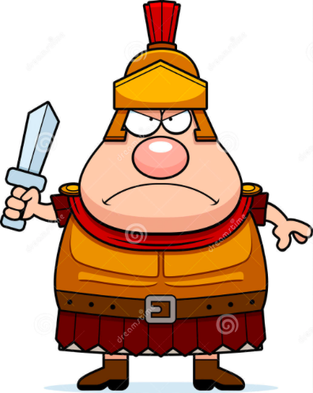
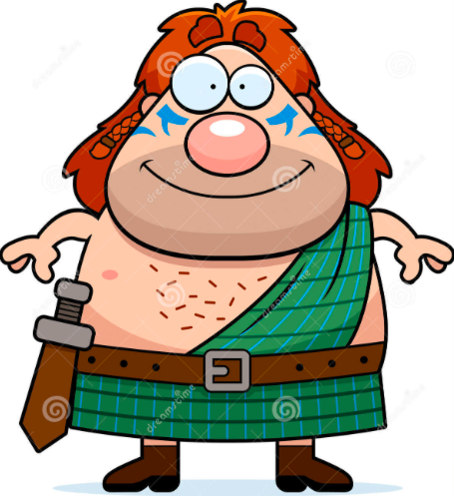
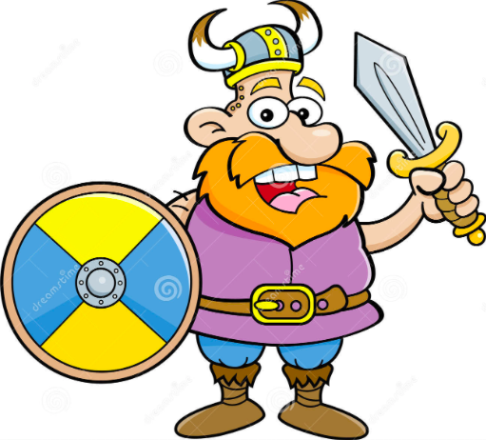
Language jigsaw!
Jèrriais is a variety of the Norman language spoken in Northern France. It has evolved over the centuries and has had many different influences…
Then in 57 BC the Rotten Romans came along with the Latin language.
Then in the 9th Century the Vicious Vikings invaded bringing with them the Norse language.
In ancient times Western Europe was known as Gaul. Jersey was part of this region and its people (Cut-Throat Celts) probably spoke Gaulish.
During the 3rd Century the area was frequently invaded by Germanic tribes including the Smashing Saxons and Fearsome Franks.
There is evidence within Jèrriais of Gaulish, Latin, Germanic, Norse, English and French.

Slide 8
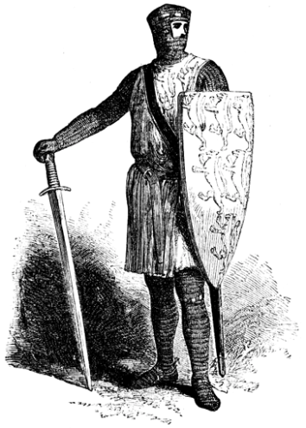
Norman rule
In 933AD William Longsword, ruler of Normandy took the Channel Islands under his control.
The Channel Islands remained under Norman rule for more than 200 years.

Slide 9
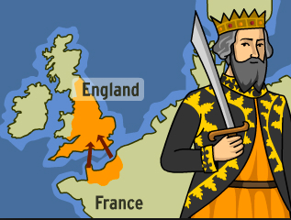
Norman rule
In 1066 Norman ruler William the Conqueror took England under his control.
So England and Normandy (including the Channel Islands) were being ruled by the same leader – the Duke of Normandy was also the King of England.

Slide 10
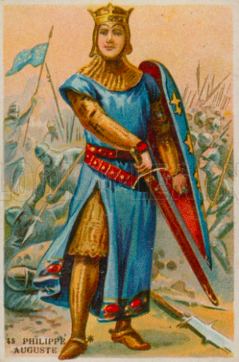
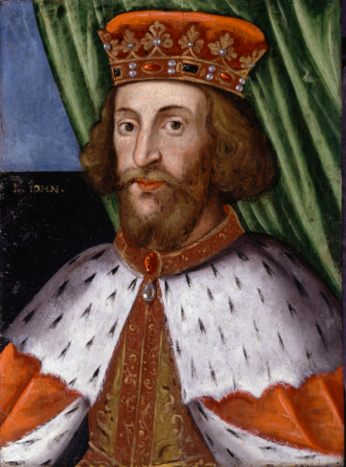
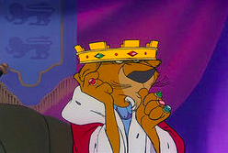
So why do we speak English?
In 1204 King John of England lost the Duchy of Normandy to King Philippe Auguste of France.
However, the Channel Islands remained in the possession of the English Crown.

Slide 11
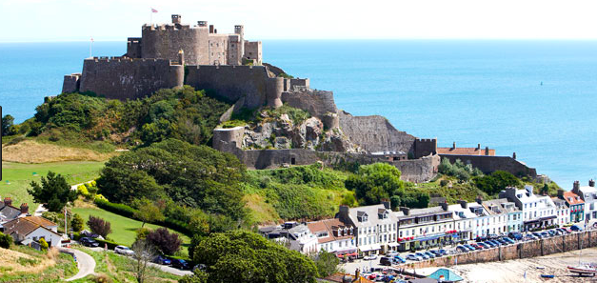
So why do we speak English?
The English sent troops over to Jersey to protect the Island from French invasion. It was around this time that Gorey Castle (lé Vièr Châté) was built.

Slide 12
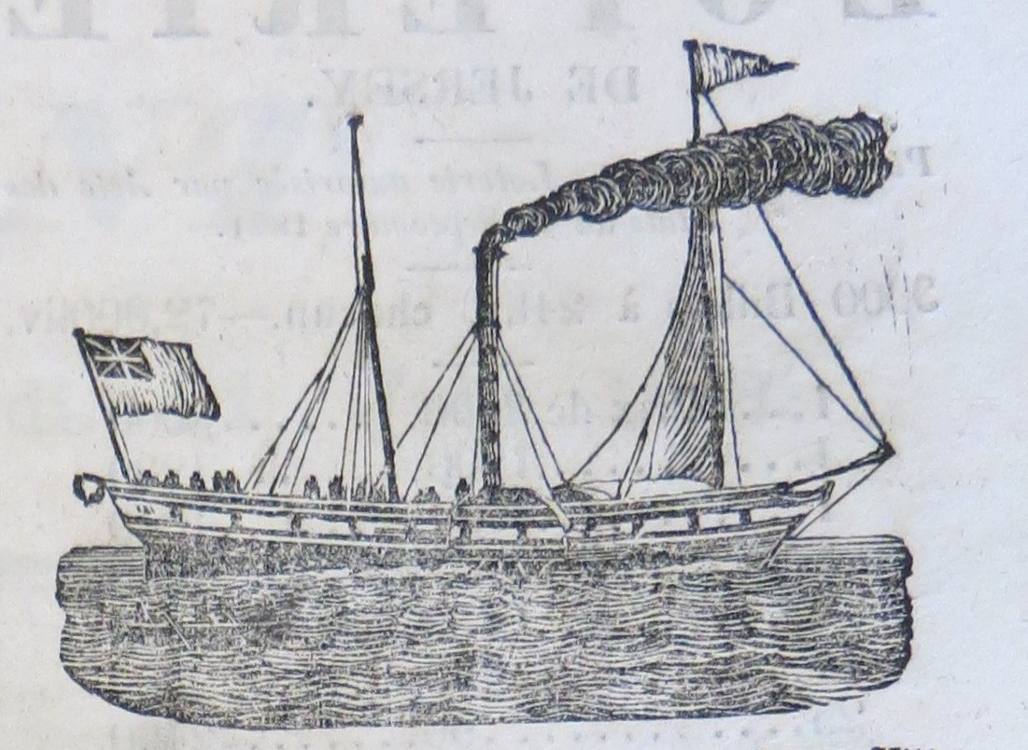
So why do we speak English?
Over the next 600 years English troops continued to come and go, bringing with them English-speaking labourers and tradespeople.
Then in the 19th Century regular paddle steamer services began between Jersey and England and increasing numbers of people from England, Scotland and Ireland started coming over to work.
It wasn’t long before Jersey had a thriving tourist industry.
Notes:
This is an engraving of the first paddle steamer to visit Jersey in 1822.

Slide 13
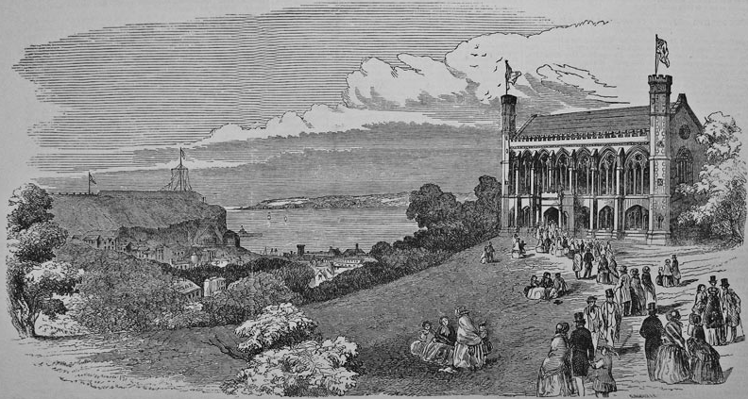
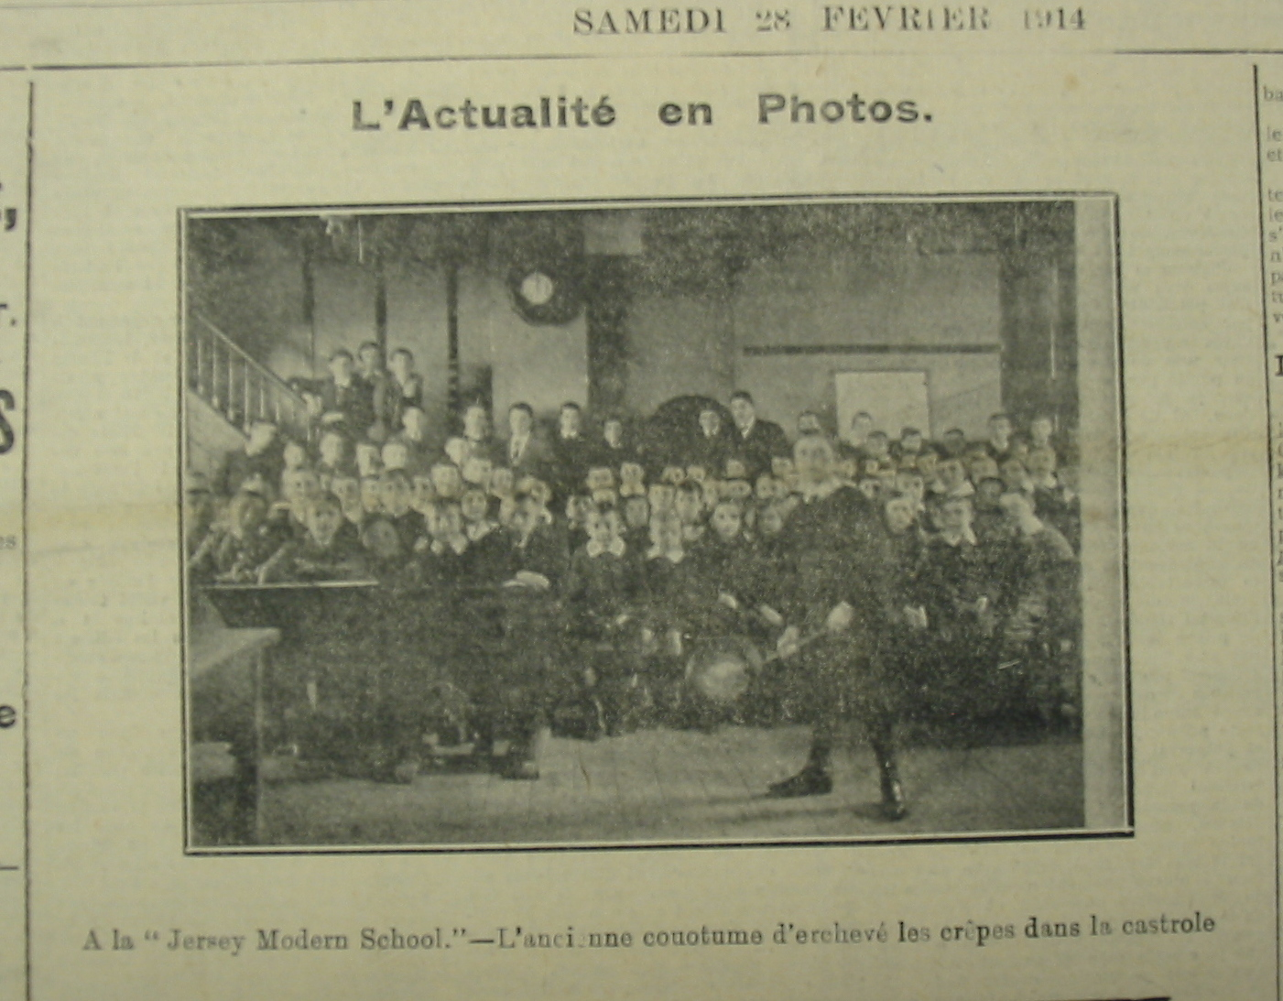
No more Jèrriais!
In 1852 Victoria College opened, where lessons were taught exclusively in English.
As time went on more and more schools discouraged children from using Jèrriais.
Notes:
This photo was published in La Nouvelle Chronique – a Jersey newspaper written in French. The caption is written in Jèrriais. The children will have been taught in English at that time.

Slide 14
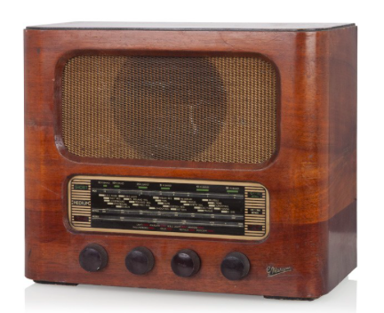
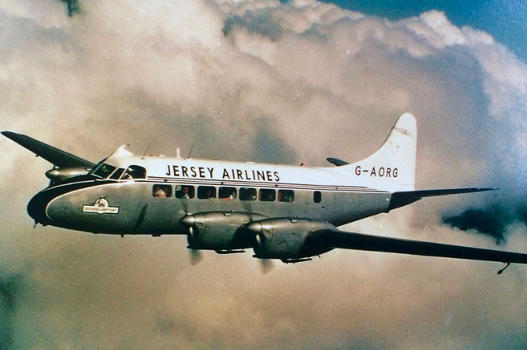
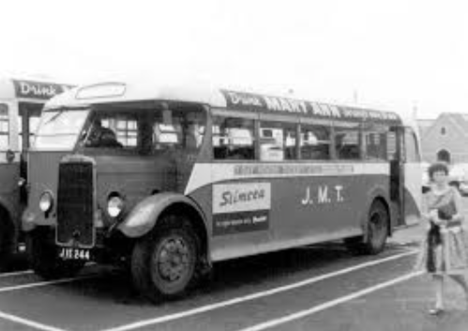
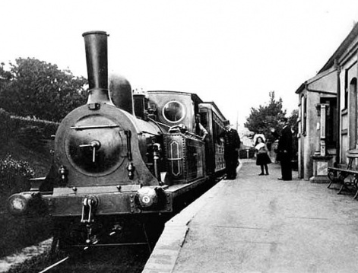
The English advance
Advances in technology led to increased exposure to the English language.
Air travel brought more English speakers over and made it possible for more Jèrriais speakers to leave.
Transport within the Island improved and people were able to visit St Helier more often.
Notes:
Until the runway was built in 1937, planes used to land on the beach at West Park.

Slide 15
Why do we want to learn Jèrriais?
There are less than 1000 Jèrriais speakers left! 😳
If we lose the Jèrriais language, we lose a part of what makes us unique.
Understanding Jèrriais helps us to understand our island better – place names, official titles, customs and traditions.
Lots of Jersey’s history is only written in Jèrriais. If we cannot read the literature and stories we have in our archives we will never know what these documents have to tell us.
The language is packed full of expressions and sayings (ditons) that tell us about the Island’s:
History: farming and fishing industries in days gone by.
Geography: what it used to look and feel like in different parts of the Island and how it has changed over the years..
Culture: how people of past generations lived; what they cared about, what made them laugh and what made them worry.

Slide 16
Find out more…
Jèrriais, Jersey’s Native Tongue by Mari Jones, published by Le Don Balleine (2003)
This is an easy read and explains the roots and evolution of the language in layman’s terms.
A Brief History of Jèrriais by N C W Spence, published by Le Don Balleine (1993)
This is a much more detailed and technical read.
Both books are available at Jersey Library and can be purchased from l’Office du Jèrriais, telephone 01534 449291

